Slide 1
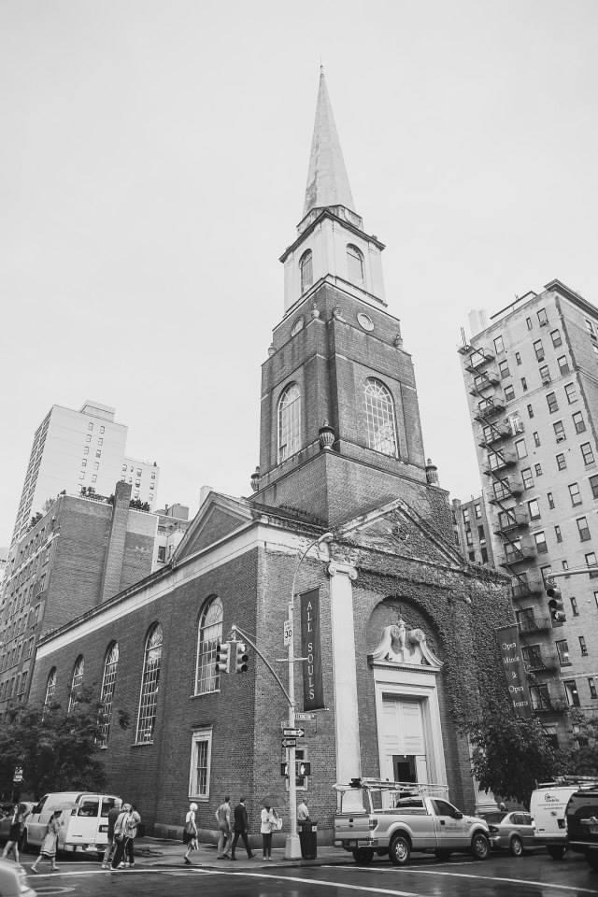
All Souls NYC Historical Society Artifacts for Women’s Alliance Welcome Back Party
September 17, 2024

Slide 2
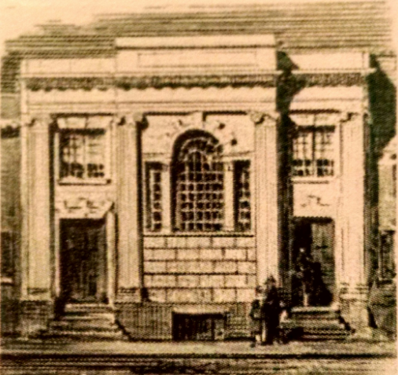
Our first building was at Broadway and Reade Street.
Known
originally as
First Church
In 1820

Slide 3
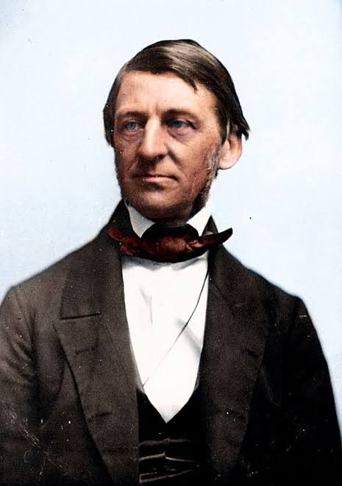
1838 – Ralph Waldo Emerson delivered his famous “Divinity School Address” to the Harvard graduating class
Ralph Waldo Emerson
He urged Unitarians to focus on their own lives and experiences of the sacred.
1803-1882

Slide 4
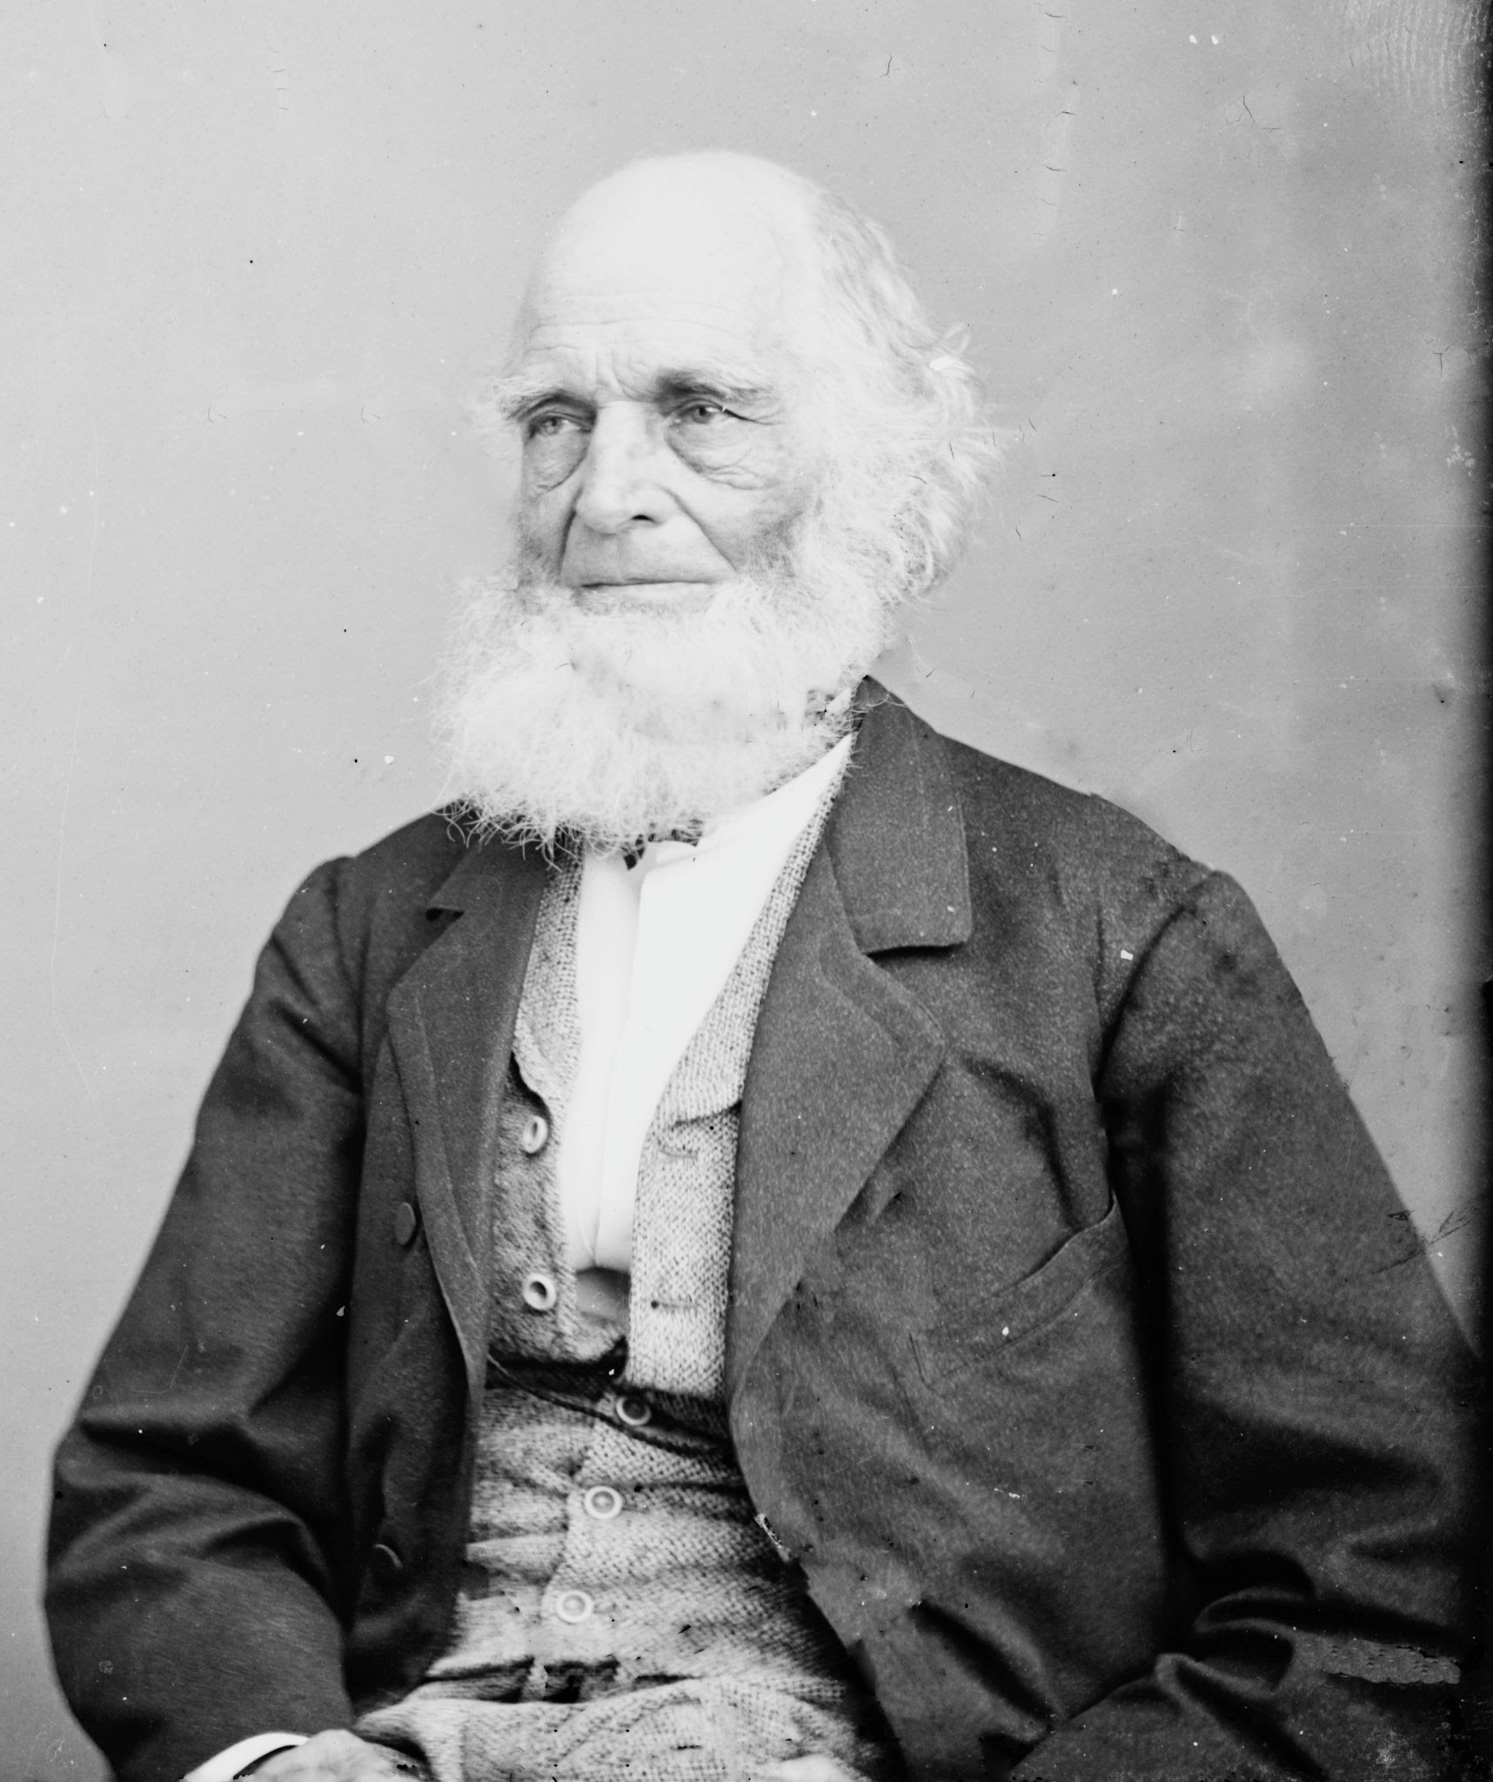
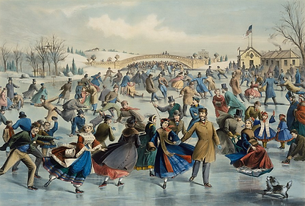
1844 – William Cullen Bryant, an All Souls member, wrote in the New-York Evening Post, an article arguing for the creation of a large public park on what is now the Upper East Side
William Cullen Bryant
In 1855, Olmstead & Vaux began the design for Central Park
1794-1878
Central Park in 1862 by Currier & Ives

Slide 5
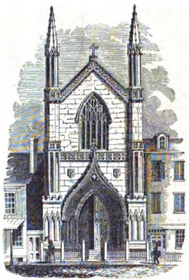
Church of the Divine Unity
Our second church building, on Broadway, between Prince and Spring Streets
In 1845 the congregation changed its name to the Church of the Divine Unity honoring one united deity.

Slide 6
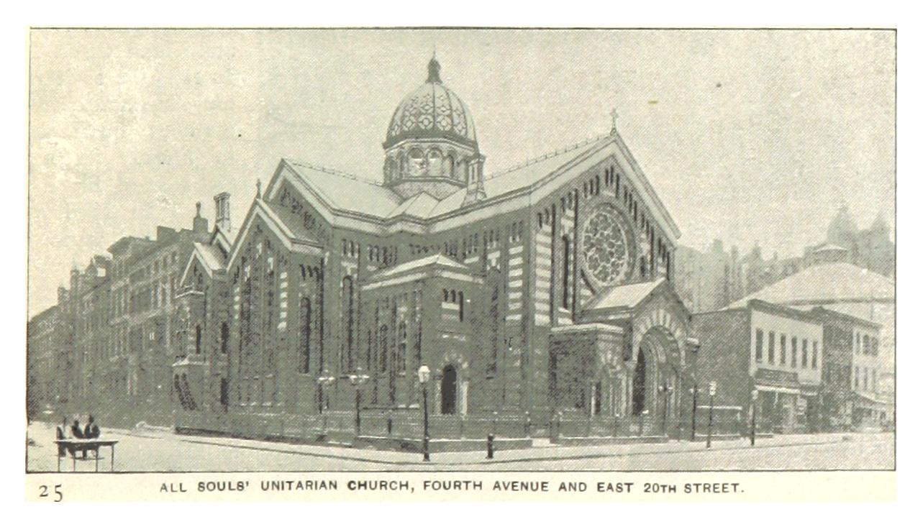
Our Third Building
1855 – The congregation changed its name to the Unitarian Church of All Souls upon its move to Fourth and East 20th Street, NYC.

Slide 7
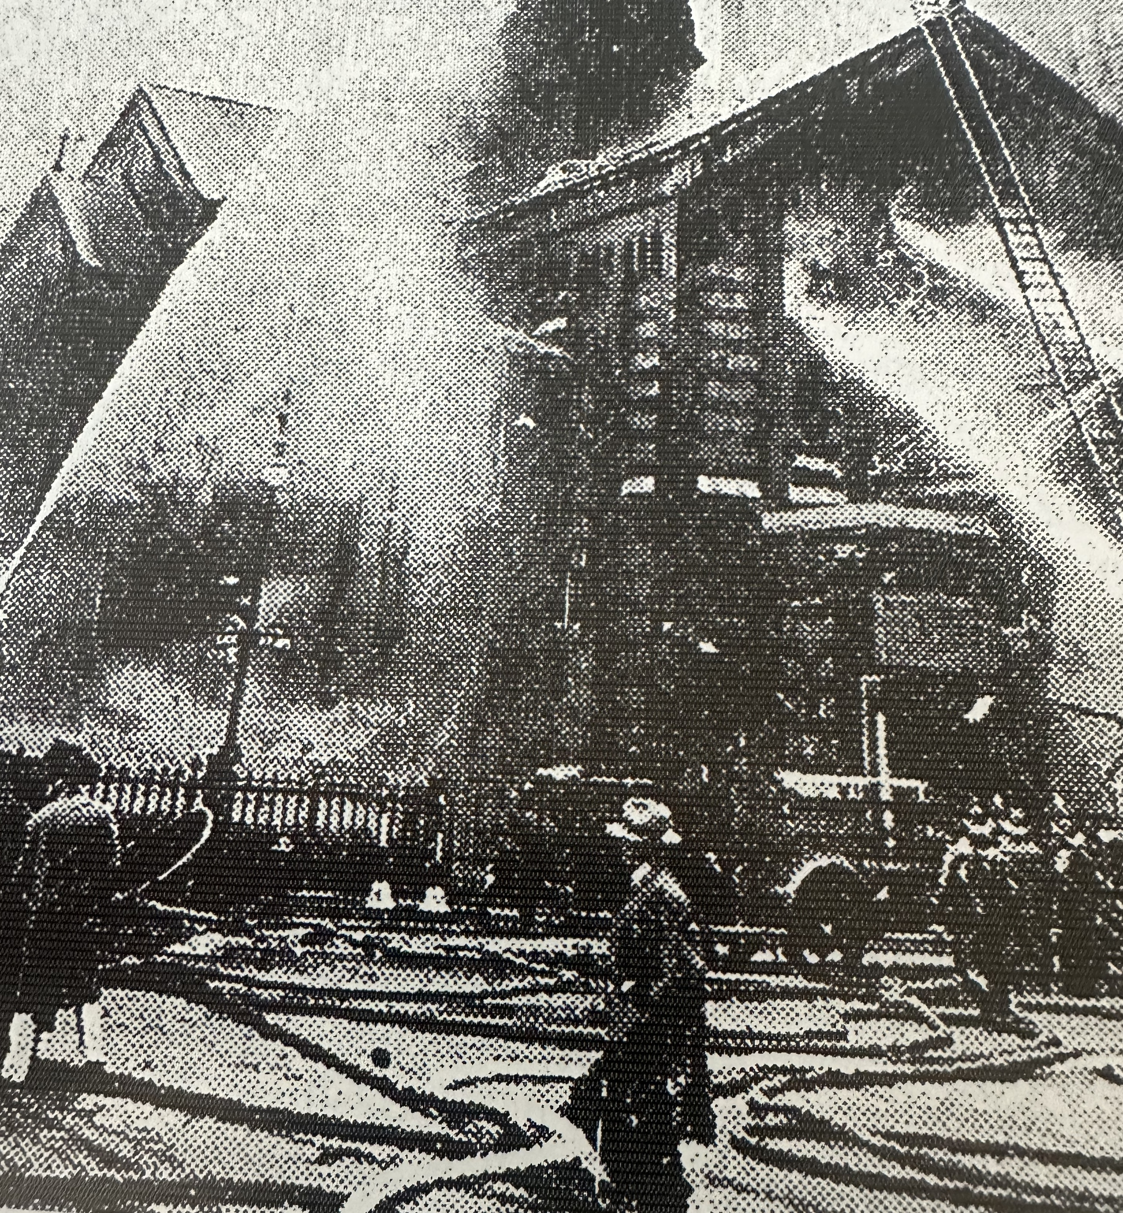
August 24, 1931 – Our third church building catches fire. The cause was unknown but it was suspected it caught fire from a cigarette.
Contractors had begun demolishing the building when fire broke out.
The Church located at 4th and 20th Streets was modeled after the Italian Basilica at Monza, Italy by Architect I. Wray Mould

Slide 8
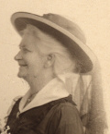
Annie Eaton and her husband, Dorman Eaton, attended All Souls. She was Superintendent of the Mission School, and when she died she left money to several charities run by All Souls.
Annie Eaton
The money Annie Eaton left is now distributed annually by the Annie Eaton Society.
1862-1958

Slide 9
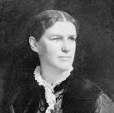
In 1863, Louisa Lee Schuyler, who was a member of All Souls, became the secretary of the Women’s Central Ass. of Relief for the Army.
Louisa Lee Schuyler
Louisa Lee Schuyler was the great-granddaughter of General Philip Schuyler and of Alexander Hamilton
1837–1926

Slide 10
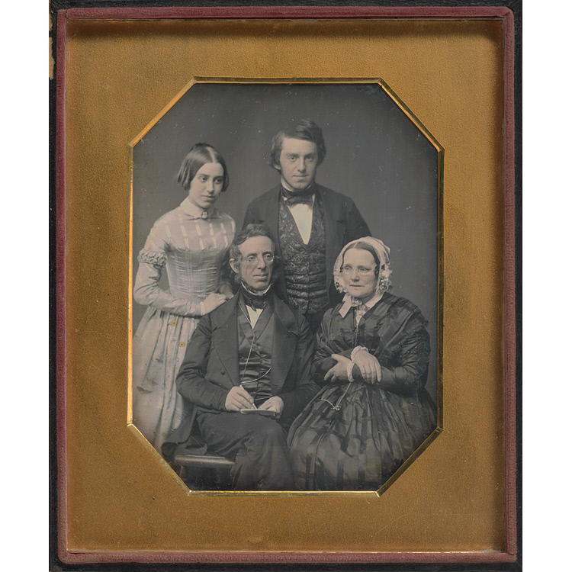
Peter and Sarah Cooper
Family
Both Peter and Sarah were active members of All Souls. He founded Cooper Union. She co-founded the Women’s Central Association of Relief for the Army
This hangs in the National Portrait Gallery
Washington DC
Peter: 1791-1883

Slide 11
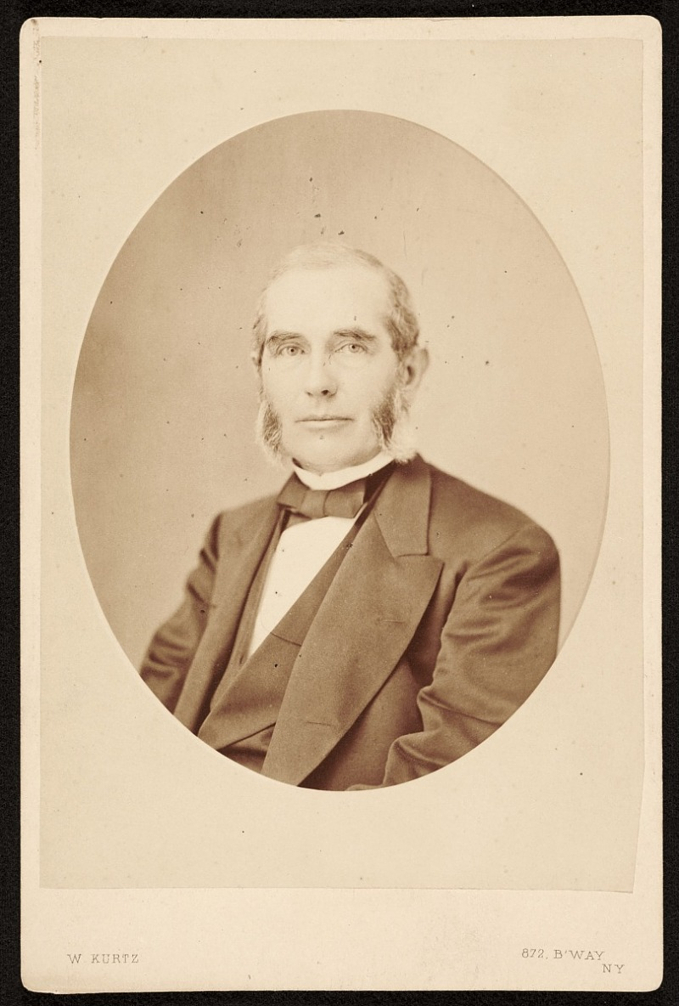
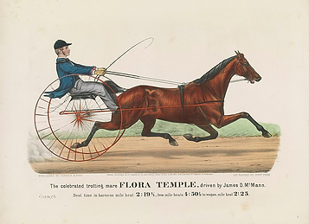
Nathaniel Currier
An All Souls member, Currier was an American lithographer and head of Currier & Ives, with James Ives.
1813–1888

Slide 12
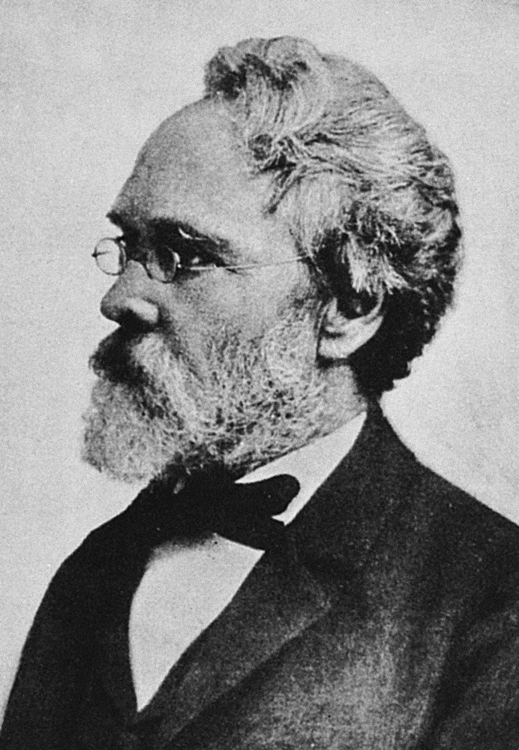
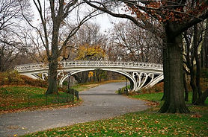
Calvert Vaux
An English architect who moved to New York in 1852 was an active member of All Souls, co-founded the American Institute of Architects.
Most of the built features of Central Park were designed by Vaux.
1824–1895

Slide 13
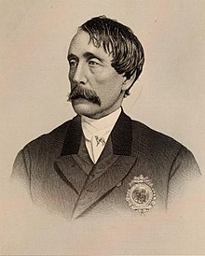
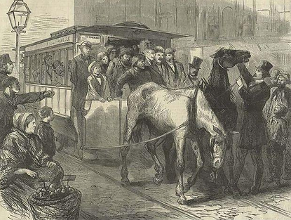
Henry Bergh
1865-An All Souls member, founded the American Society for the Prevention of Cruelty to Animals (ASPCA).
1813-1888

Slide 14
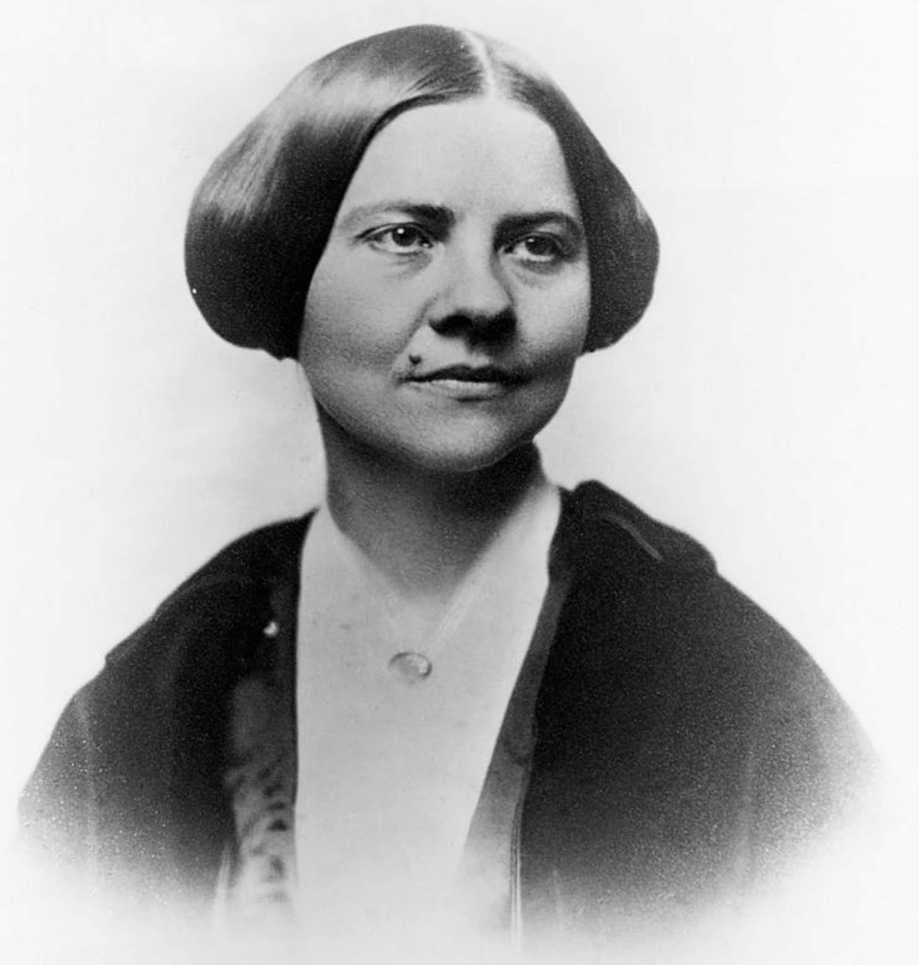
Rev. Olympia Brown
The first woman ordained as a minister by any denomination in the US in 1919
She was ordained in the Universalist Church
1835-1926

Slide 15
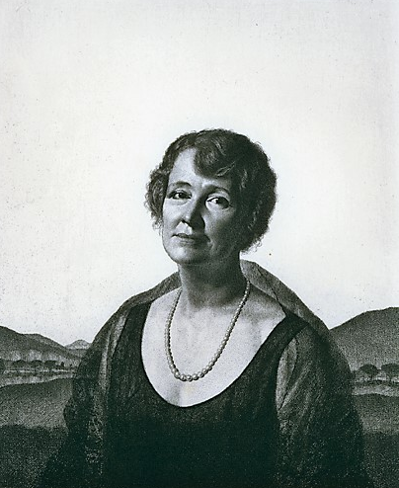
Jessie Duncan Wiggin
Jessie Duncan Hayden Wiggin and her husband, Albert, were members of All Souls for many years. He was the chairman of Chase National Bank. After his death in1951 she gave $300,000 to All Souls for the construction of Wiggin House.
She was a sculptor
1872 - 1954

Slide 16
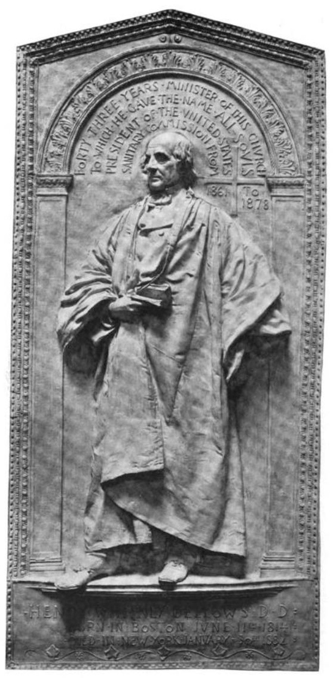
1886 – A bronze bas-relief of Henry Whitney Bellows by the well-known sculptor Augustus Saint-Gaudens (1848-1907) sits in our sanctuary. Saint-Gaudens was an American sculptor of the Beaux-Arts generation.
Henry Whitney Bellows
1814–1882

Slide 17
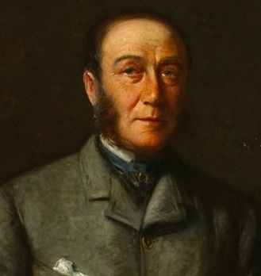
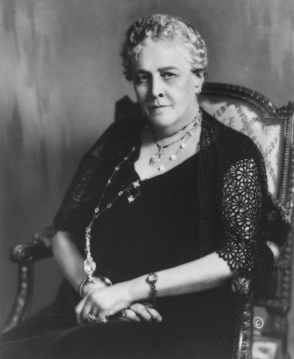
1888-Sarah Delano married James Roosevelt
The Delano family were Unitarians and attended All Souls when they were at their Manhattan home.
​
Their son, Franklin Roosevelt was elected President of the United States in 1932 and considered himself Episcopalian.

Slide 18
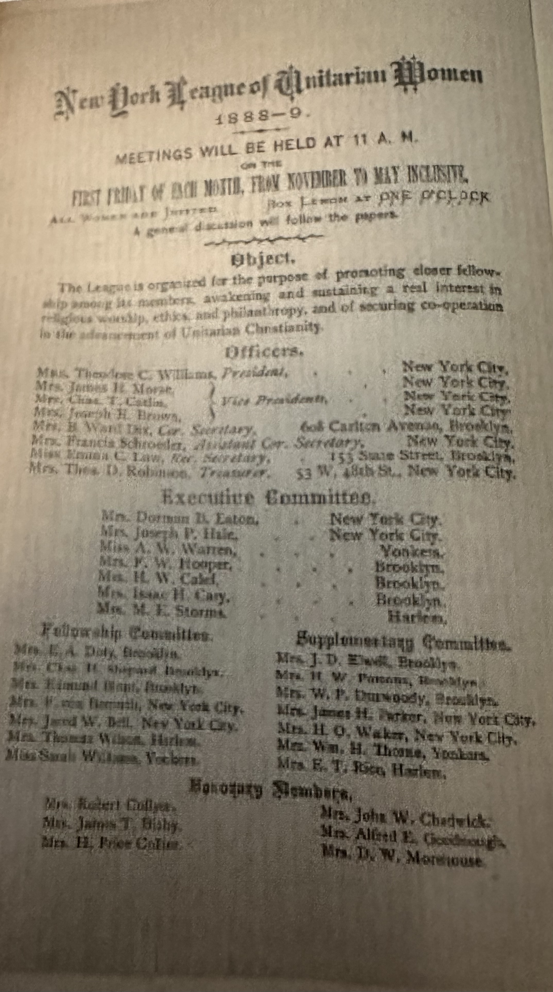
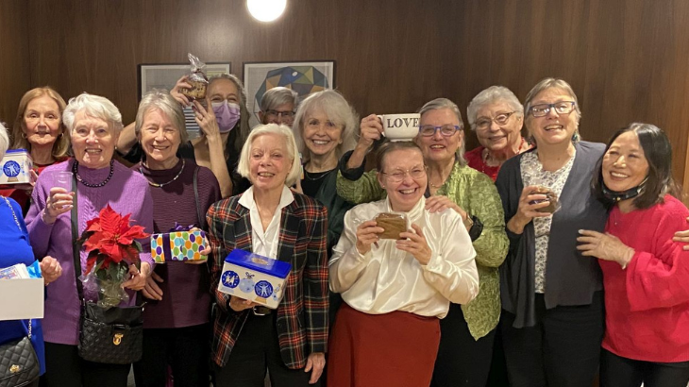
The Women’s Alliance was formed in 1890
This organization took responsibility for running the very popular Church Fairs.
Originally named “New York League of Unitarian Women”
Our 2024 Women’s Alliance

Slide 19
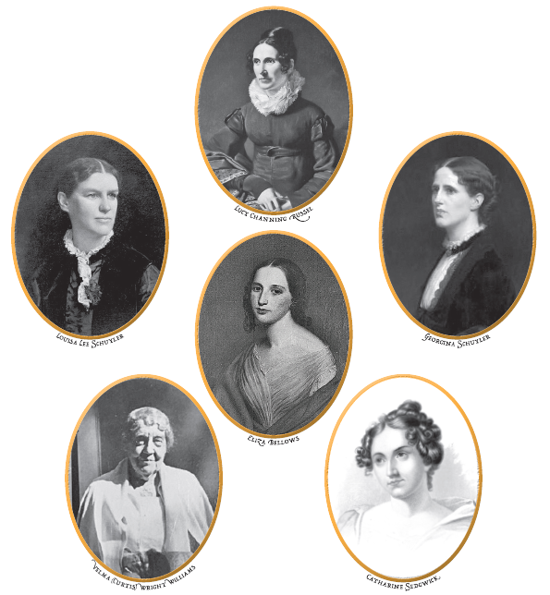
Early
Women of
All Souls
Lucy Channing Russell
Georgina Schuyler
Catharine Sedgwick
Vilma Williams
Eliza Bellows
Louisa Lee Schuyler

Slide 20
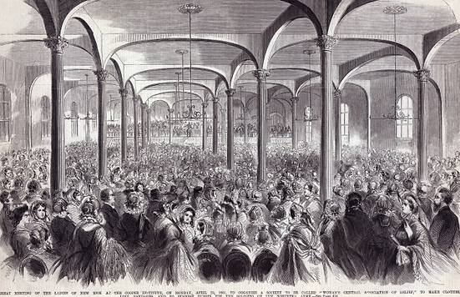
1861 – The Woman’s Central Association of Relief for the Army was formed at this ladies meeting at Cooper Union.
Louisa Lee Schuyler, an All Souls member, became the secretary in 1863.
Rev. Henry Bellows, lead 50 ladies to start planning a Metropolitan Fair to raise funds and supplies for the Union Army.

Slide 21
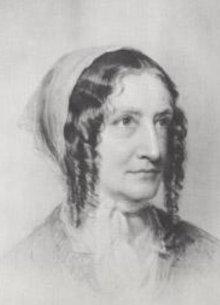
Catharine Sedgwick was an All Souls member and the most famous novelists of her time. Hope Leslie (1827) is her best-known novel.
Catharine Sedgwick
1789–1867

Slide 22
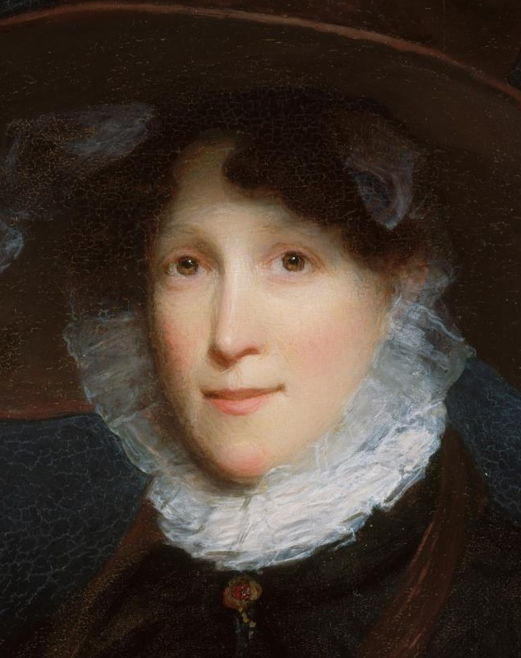
Mary Waterhouse Ware
Married William Ware, All Souls minister.
She was the daughter of Dr. Benjamin Waterhouse, the Harvard physician who introduced the smallpox vaccine in America.
1799-1872

Slide 23
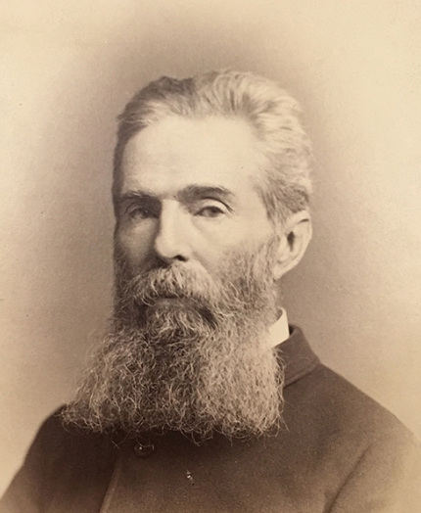
Herman Melville was an American novelist best known for his 1851 book, Moby Dick. He and his family were members of All Souls.
Herman Melville
1819-1891

Slide 24
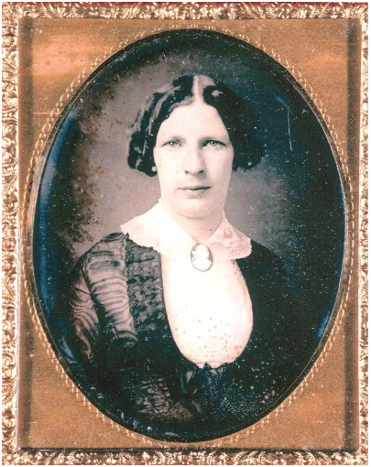
“Lizzie” Shaw, daughter of the Chief Justice of the Massachusetts Supreme Court, married Herman Melville in 1847. They paid for a pew at All Souls.
Elizabeth Shaw Melville
1822-1906

Slide 25
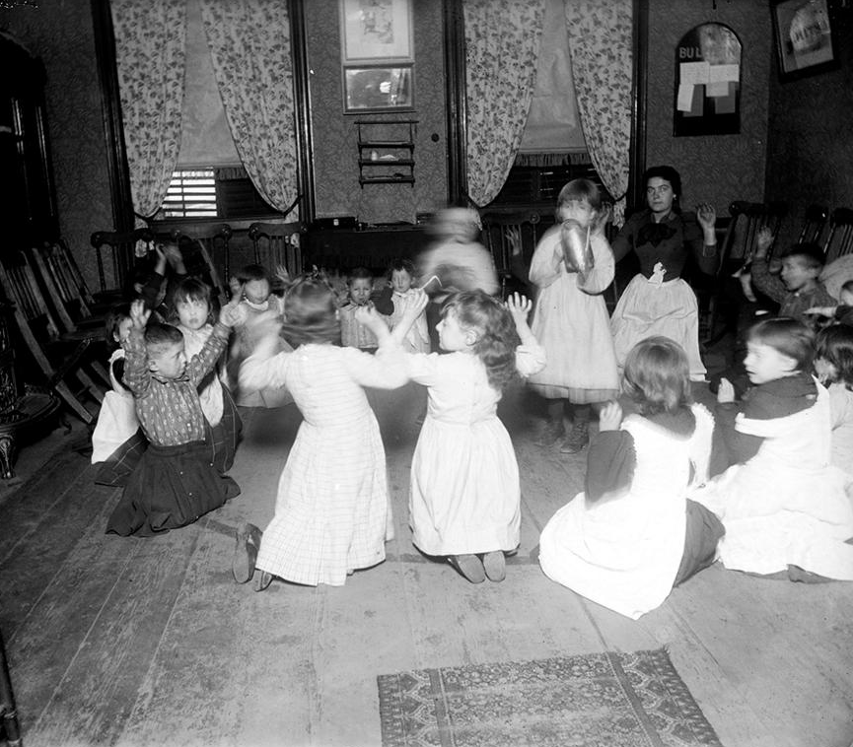
The Charity School
The Children in Kindergarten
Operated by the women of the church, was started in 1823. At a time when most children were educated at home and the wealthy had tutors, a free school was set up in the church basement to teach those less fortunate.

Slide 26
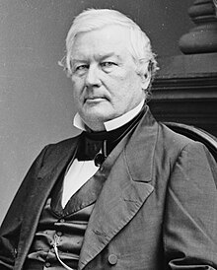
Millard Fillmore
A Unitarian who became the 13th President of the United States, upon the death of Zachary Taylor in 1850. He served until 1853.
1800-1874

Slide 27
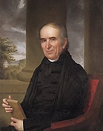
The 1803 “Unitarian Controversy”
This Controversy erupted between liberals and conservatives within the Congregational Church over the appointment of the next Hollis Professor of Divinity at Harvard Divinity School.
In 1805, the liberal minister Henry Ware
was selected. His son
was William Ware.

Slide 28
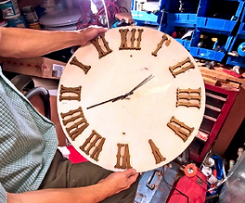
1821 Clock
Originally a gift from George Bond of Boston, this clock has hung in each of the church’s four buildings.
The Historical Society funded the restoration of the clock during the Bicentennial

Slide 29
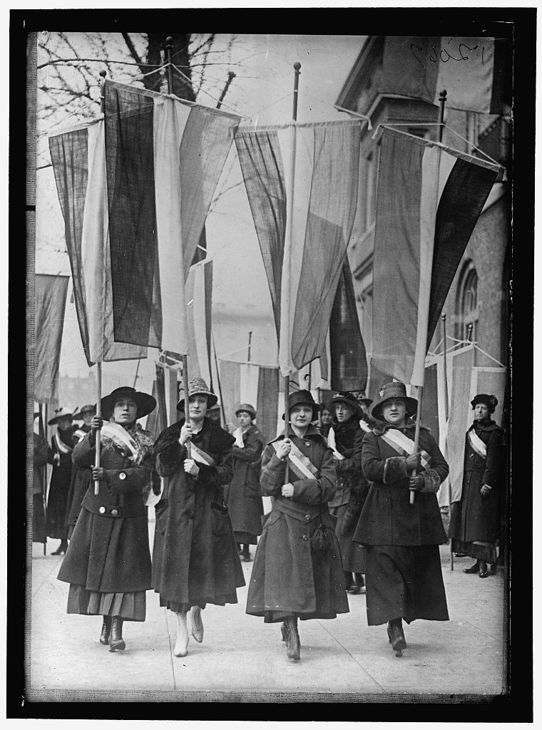
Women's Suffrage March, 1916.
Library of Congress.
All Souls Members:
Gertrude McGinley
Georgina Schuyler
Velma Wright Williams
Sara Delano Roosevelt

Slide 30
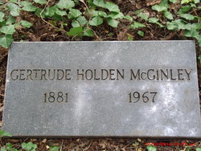
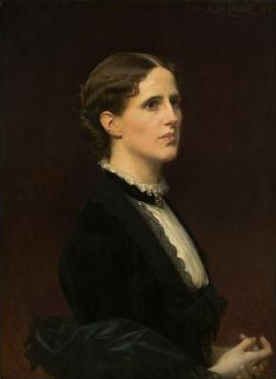
1920 – With the passing of the 19th Amendment to the US Constitution, the women members of All Souls could now vote. They could also become full voting members of the church and be elected to the Board of Trustees.
​
In 1923, the first two women were elected to the Board of All Souls:
Gertrude Holden McGinley
Georgina Schuyler
Georgina Schuyler 1841-1923* (died after election)

Slide 31
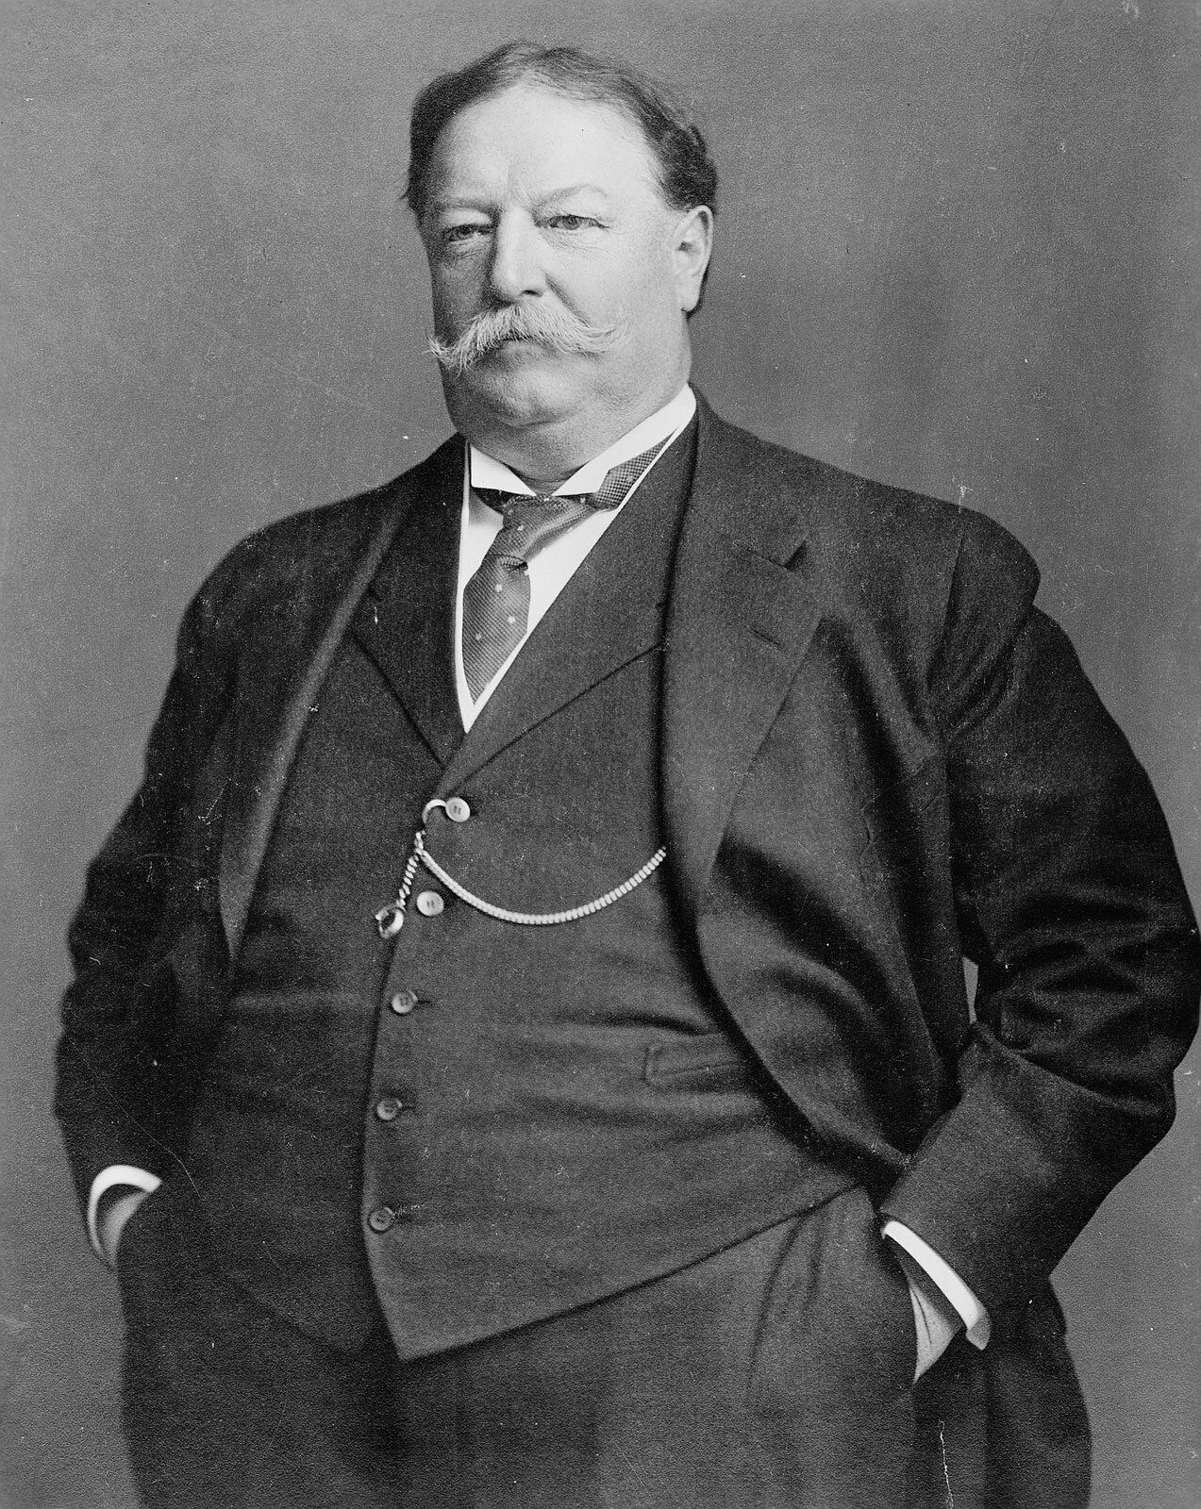
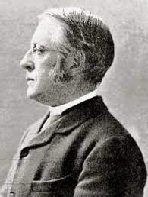
1919 – All Souls celebrated its 100th anniversary.
William Taft, former President of the US, and Charles Eliot, former president of Harvard, came to celebrate.
William Taft
The congregation raised $100,000 to pay off the church’s long-standing debit.
Prohibition had just begun so a sober two-day celebration took place.
Charles Eliot

Slide 32
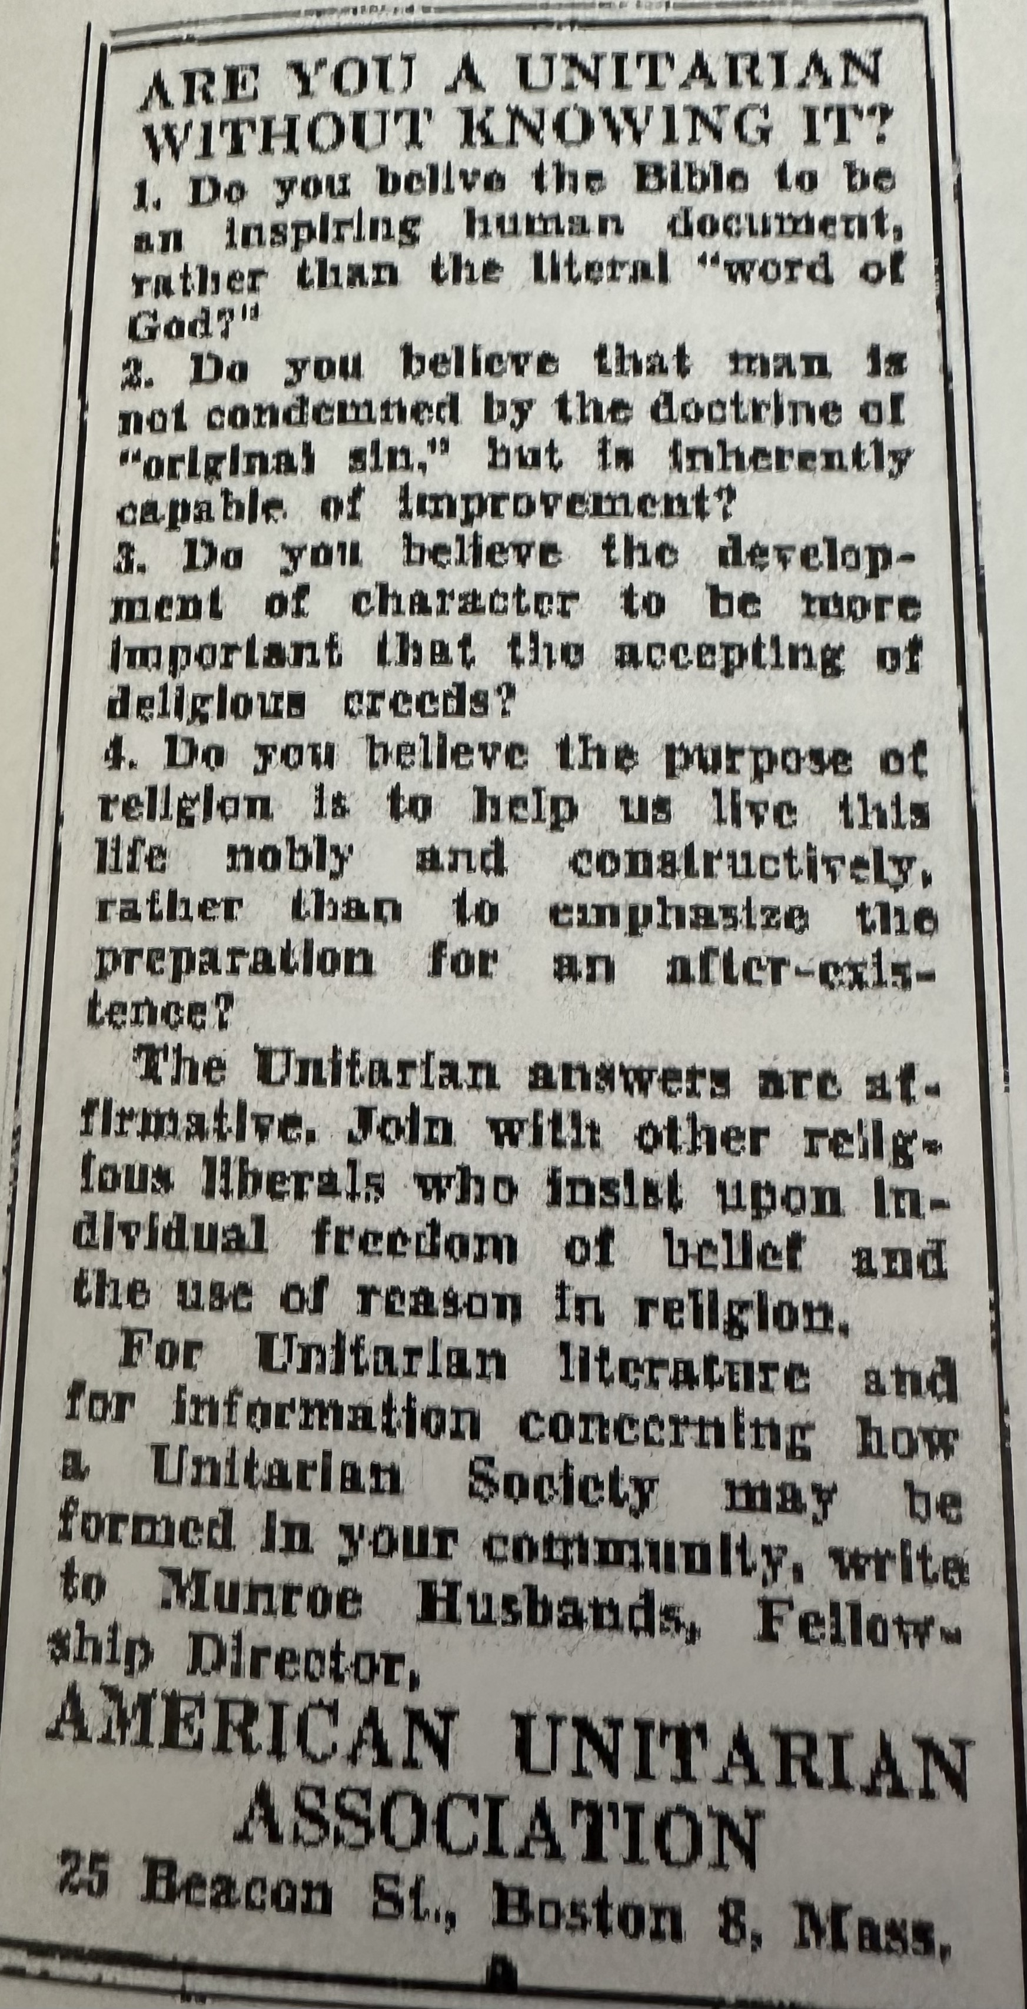
1919 – The All Souls Chapter of the Laymen’s League was formed.
Met once a month for dinner with guest speakers during WW II. It later was defuncted but was revived in 2016.
In the 1950s, the group ran ads which asked “Are you a Unitarian without knowing it?”

Slide 33
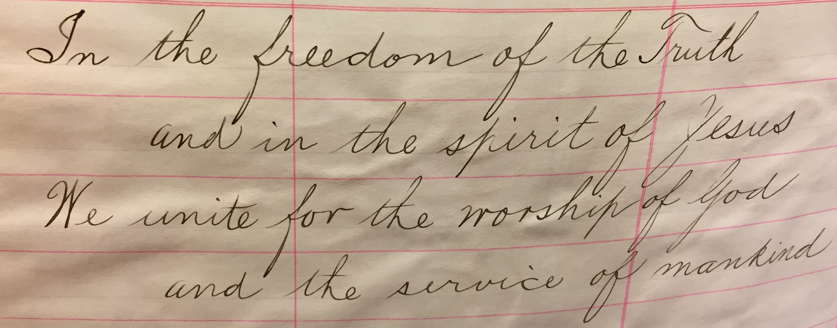
Our 1922 Bond of Union.
Today’s Bond of Union:
“In the freedom of the truth, and in the spirit of love,
We unite for the worship of God, and the service of all.”

Slide 34
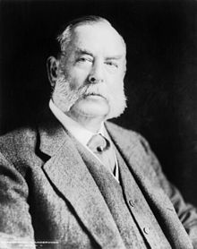
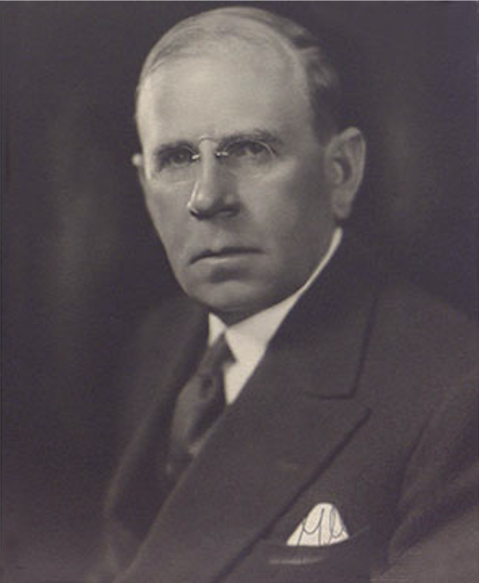
The Wall Street Crash of 1929 hit All Souls hard.
Many donors were unable to fulfill their pledges for the new, fourth, building being planned on Lexington Avenue at E. 80th St. Help came from the estate of George F. Baker, an All Souls member and President of what is now Citibank. His son, also George F. Baker, covered the mortgage for the current building when his father died in 1931.
1840-1931
1878-1937
The two George F. Baker’s

Slide 35
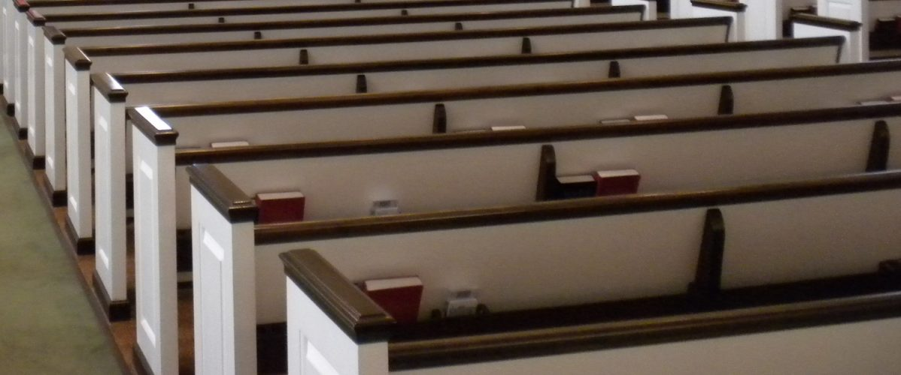
1932-The decision was made to phase out the rental of pews, a policy which had been in place at All Souls since 1821. The Trustees decided to move towards a policy of a “free church,” with every member annual canvasses.
1840-1931
1878-1937

Slide 36
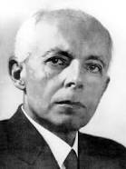
1945 - The funeral of Béla Bartók, the great Hungarian Unitarian composer, was performed at All Souls.
Béla Bartók
He joined the Unitarian faith "primarily because he held it to be the freest, most humanistic faith." He called the trinity a "clumsy fable that enslaves thought."
1881-1945

Slide 37
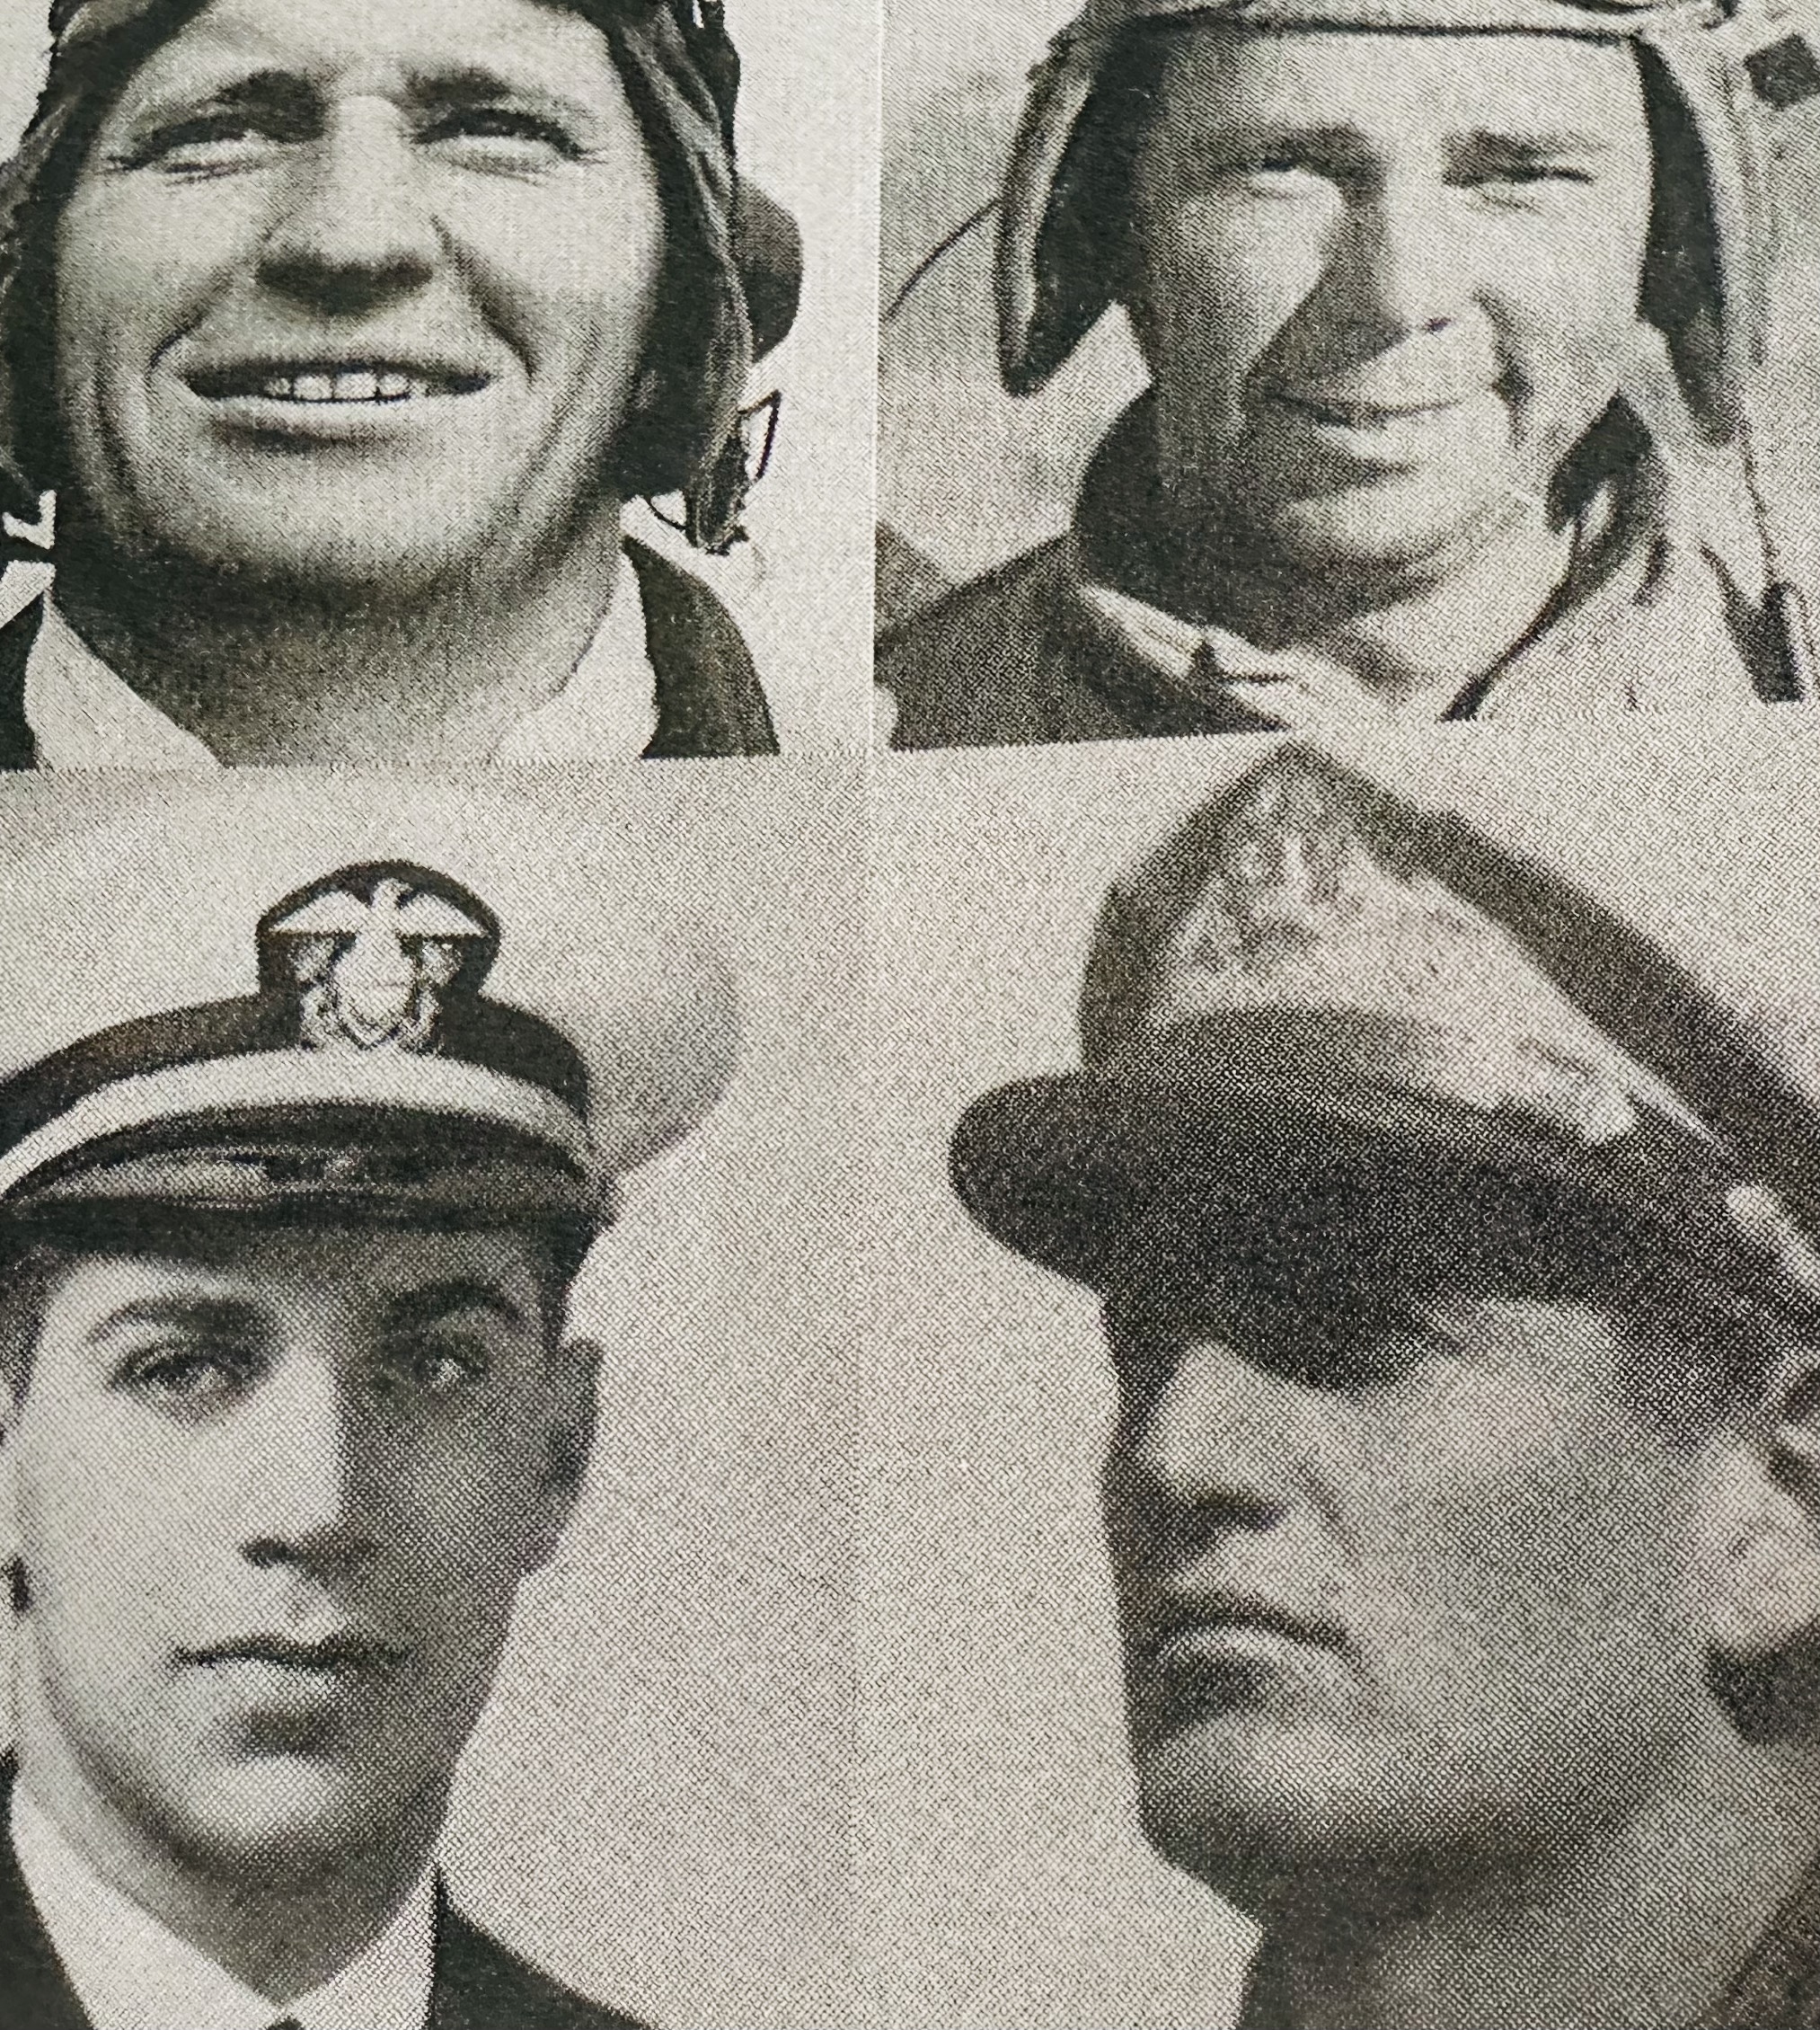
During World War II, 140 All Souls members served in the military.
Four gave their lives:
Jacques Rodney Eisner
Frazier Curtis
Adolf Paul Schramm Jr.
James Freeman Curtis
1941-1945
Frazier & James were brothers

Slide 38
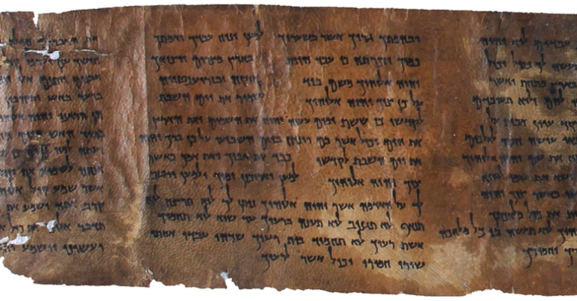
Through a generous gift, All Souls purchased one of the Dead Sea Scrolls titled “All Souls Deuteronomy” around 1958. The original sits in a Jerusalem Museum.

Slide 39
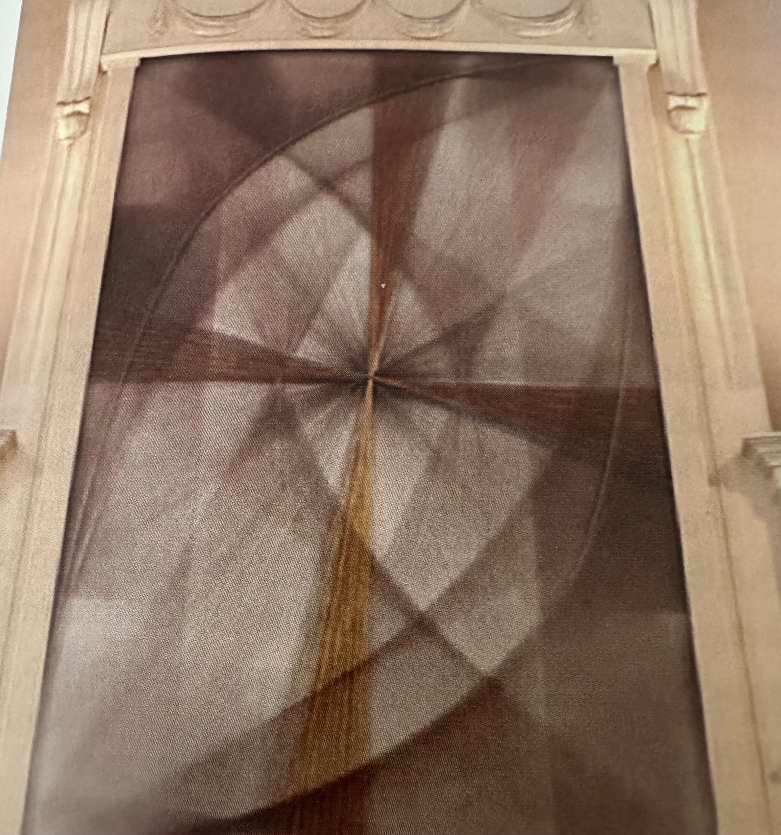
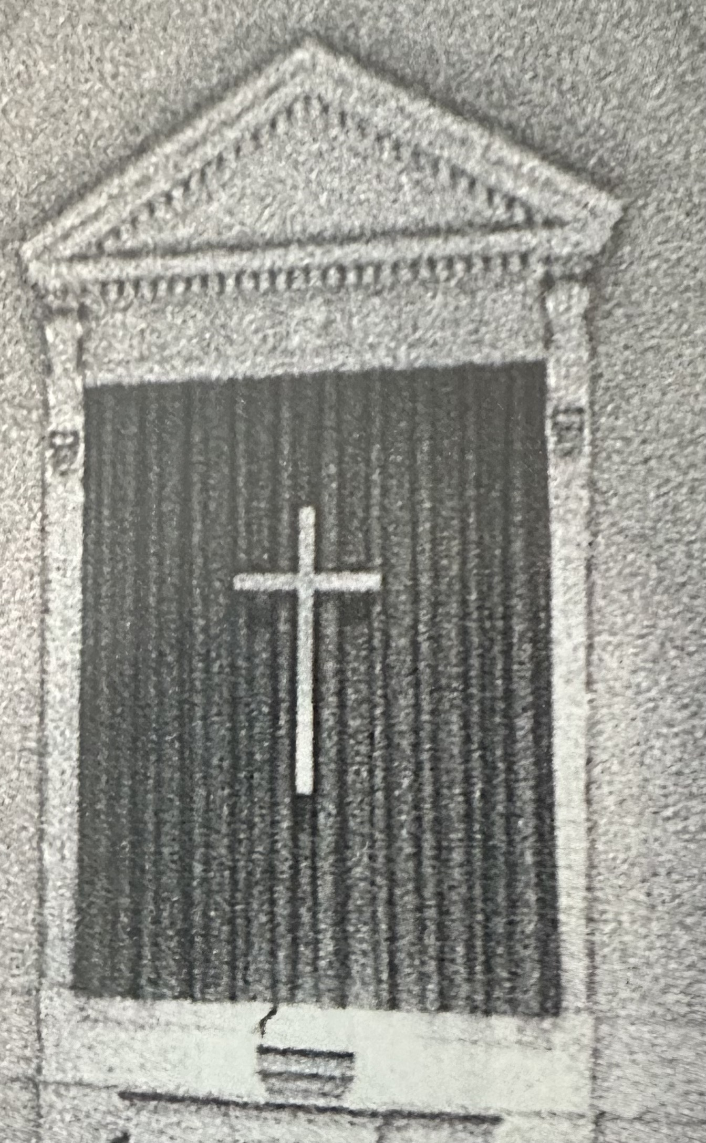
In 1980, the Cross on the Chancel was dedicated to replace the with a commissioned piece of art by Sue Fuller
1940 – Rev. Minot Simons had the cross from the third church building installed in the Lex & 80th chancel.

Slide 40
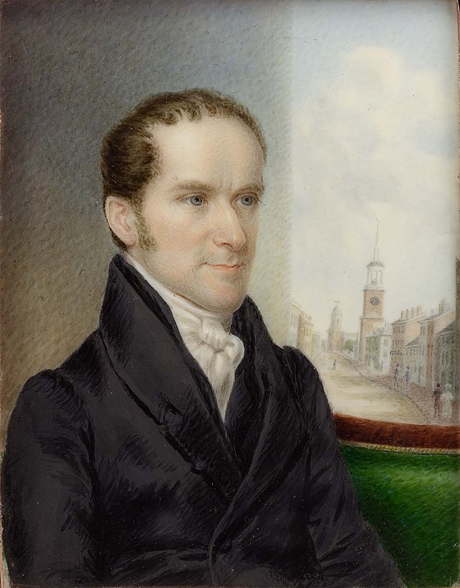
William Ware
1821-1835
Henry Bellows
1838-1881
Theodore Chickering Williams
1882-1896
Thomas Slicer
1897-1916
William Sullivan
1916-1922
Minot Simons
1922-1941
Laurance I. Neal
1941-1955
Donald Kring
1955-1978
Galen Guengerich
2007 - 2024
Forrest Church
1978-2007
All Souls Senior Minsters through the years

Slide 41
Adlai Stevenson visiting All Souls, to the left of Dr. Kring
Around 1960

Slide 42
Friday Soup Kitchen
Beginning in 1977, the Friday Soup Kitchen has been operating with its mission is to feed our less fortunate neighbors with a hot, nourishing meal, served with dignity and respect for every person.

Slide 43
Dr. Kring’s Stained-Glass Altar piece
Created in the 1970’s by Dr. Kring, its symbols of the world religions are touching each other, indicating one great family of humankind.

Slide 44
Bust of our 8th Minister Dr. Walter Kring
Dr. Kring retired in 1978

Slide 45
Leonard Bernstein preached a sermon at All Souls in 1985
Leonard Bernstein
He was part of a series of guest preachers invited to talk about “Hope in the Nuclear Age”

Slide 46
The Holtcamp Organ
This magnificent Holtcamp organ was installed in 1989, and has 3 manuals, 40 stops, and 53 ranks.

Slide 47
Our Magnificent Directors of Music
1942-1965
1965-1975
1975-2014
2015 - Present
William
Brewster
George B.
Markey
Alejandro Hernandez
Valdez
Walter Klauss

Slide 48
Our AIDS Task Force
The earliest years were characterized by shock: the shock that the All Souls poster campaign elicited, and the shocking realization of how profoundly AIDS was impacting New York City.
1987
AIDS is a human disease; it requires a humane response

Slide 49
Sculpture in the Garden
“Milka and Tiraz” bronze with bluestone base sculpture, 1990,
by Boaz Vaadia.
The sculpture was given to the All Souls School by Mr. Vaadia in 1996

Slide 50
All Souls was awarded the "Excellence in Accessibility" by the Friends of the Upper East Side Historic Districts in January 2002.
The below plaque was awarded by the UUA

Slide 51
The Girls with the Balloons
This bronze work, sculpted by Euphemia Glover, was cast by Harold Castor from model seen by Dr. Kring, 1955-1978, who wanted it for our Garden. It is dedicated to the memory of two All Souls children
who died in infancy.
A nearby plaque dedicated to their memory reads "I invite you to be friendly with my trees, my flowers and my wild creatures".

Slide 52
Channing Lectern
William Ellery Channing’s portrait is hand carved on the face of this mahogany piece.
Purchased from the Plainfield church when it closed in 2018.

Slide 53
November 19, 2000
Dedication of the Friendship and Memory Wall
Forrest appears to be pointing at the location of Time Capsule.

Slide 54
Margo Adler
A broadcaster, reporter, author, social critic, and leading figure in American paganism & member of All Souls
Her coverage of current events on public radio was always among the most dramatic and revealing of any national coverage.
1946-2014

Slide 55
I was at the church to perform a 11 AM wedding. The couple and wedding party were due to arrive at 10:30 AM. I didn’t bother to look into the church to see if it was ready for the wedding. We watched in horror as the South Tower collapsed.
Rev. Dick Leonard
Thoughts on 9/11
From his book Wet Cement, published in 2017
1927-2022

Slide 56
Betty McCollum
The Women’s Alliance mourned the loss of Betty McCollum to COVID-19. Betty was an ambassador for the Women’s Alliance, for All Souls and for Unitarian Universalism.
A social worker by profession with degrees from Goucher and Smith College
1941-2020

Slide 57
Monday Night Hospitality
For over 40 years, Monday Night Hospitality has served restaurant-style meals to those in need in New York City. We believe that everyone, deserves to be treated with respect and dignity.

